Slide 1
The Google File System by Sanjay Ghemawat, Howard Gobioff, and Shun-Tak Leung
32163466 이재서
Notes:
GFS란 엄청나게 많은 데이터를 보유하는 구글의 핵심 데이터 스토리지와 구글 검색 엔진을 지원하기 위해 최적화된 파일 시스템입니다.

Slide 2
Basic information
File System
Cluster
Fault tolerance
Scalability
Data storge
Clustered storge
Meta data
POSIX

Slide 3
Abstract
GFS is a scalable distributed file system for large distributed
GFS provides fault tolerance even with low cost and common computer
GFS is designed through observations of Google applications and technology environments
Notes:
구글 파일 시스템은 간단히 말하면 구글에서 만든 확장이 가능한 대규모 분산형 파일 시스템이라 할 수 있음.
구글 파일 시스템은 저렴한 일반적인 컴퓨터를 사용함에도 fault tolerance를 제공하고 합산된 높은 성능을 다수의 clients에게 제공함.
GFS는 구글 어플리케이션과 기술 환경의 관찰을 통해 설계되었음

Slide 4
Introduction
GFS has similar purpose to the previous file system, but new perspectives has also been added
Failure of one node is considered to be a general situation, not an exception.
File size is larger than before, requiring both block and I/O workload size re-examination to divide files
Most files are mutated by appending new data rather than overwriting existing data
Co-designing the applications and the file system API benefits the overall system by increasing our flexibility

Slide 5
Design Overview
Assumptions
Interface
Architecture
Single Master
Chunk Size
Meta Data
In-memory data structure
Chunk location
Operation Log
Guarantees by GFS

Slide 6
Design Overview : Assumptions
Deploy systems with affordable hardware that can potentially fail.
The system stores a small number of large files
Read workload consists mainly of two types of reads: large streaming reads and small random reads
Must be implemented efficiently when multiple clients append to one file at the same time
bandwidth is more important than low latency

Slide 7
Design Overview : Interface
GFS provides a familiar file system interface, though it does not implement ad standard API such as POISX
Moreover, GFS has snapshot and record append operations.

Slide 8
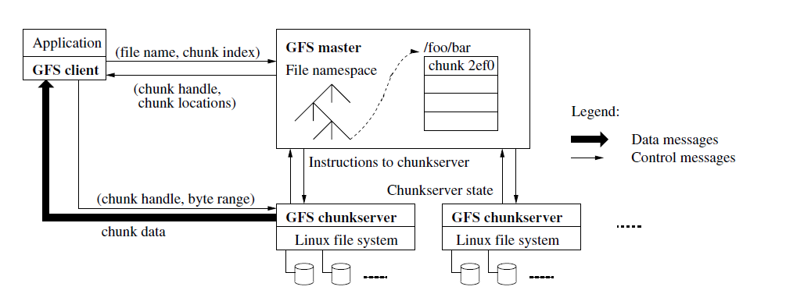
Design Overview : Architecture
Master Sever : GFS 전체를 관리하고 통제하는 중앙 서버 역할
Chunk Sever : 물리적인 서버, 실제 입출력을 처리
Client : 파일 입출력을 요청하는 클라이언트 어플리케이션

Slide 9
Design Overview : Single Master

Slide 10
Design Overview : Chunk Size, Meta Data, In-memory data structure
Chunk Size
Set to 64MB by default
Use delay space allocation
Meta Data
Save in master sever
Namespace, mapping information between file and chunk, location of chunk duplication
In-memory data structure
Structure where metadata is stored in the master’s local memory

Slide 11
Design Overview :Chunk Locations, Operation Log
Chunk Locations
Master Sever dose no have a permanent record of which chunk replica resides on which chunk server
Heartbeat signal
Operation Log
Record important meta data changes
Stored in other remote devices

Slide 12
Design Overview : Guarantees by GFS
Changing the namespace of a file is an atomic task and is managed only by the master server
Operation log record atomic task sequence
File and replicated file should ensure the consistet

Slide 13
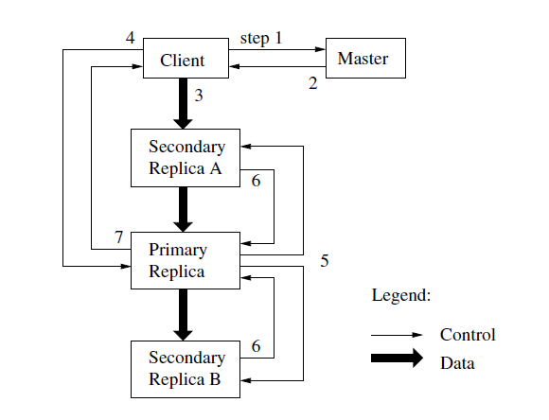
System Interaction : Leases and Mutation
step1. 클라이언트가 마스터에게 어떤 청크서버가 lease를 가지고 있는지, 그리고lease가 아닌 다른 복사본들은 어디에 있는지에 대한 요청을 하고 만약 lease가 없으면 master 서버는 복사본들중 하나를 primary로 지정한다.
step2. 마스터는 primary와 다른 복사본들의 location을 클라이언트에게 리턴해준다.
Step3. 클라이언트는 모든 복사본에 변경될 data를 전송한다.

Slide 14
System Interaction : Leases and Mutation
Step4. 모든 복제본들에게 data가 전송되면 쓰기 요청을 primary에게 전달
Step5. 프라이머리는 지정한 순서대로 모든 복사본들에게 쓰기 요청 전달
Step6. 각 복사본들이 mutation이 끝나면 primary에게 완료 메시지를 전달
Step7. 모든 복사본들이 mutation이 끝났다는 메시지를 클라이언트에게 전달

Slide 15
System Interaction : Data Flow
Notes:
파이프라이닝이란? 동시에 처리 가능한 일들을 동시에 처리함으로써 처리량을 올리는 것이 파이프라이닝임.

Slide 16
System Interaction : Atomic Record Appends
In previous file system, client determines the offset where the data will write
But in GFS, client just determine data and GFS determines the offset

Slide 17
System Interaction : Snap Shot
A snapshot is an operation that creates a copy of a file or directory
When the master receives a snapshot request, it first rebokes the leases
After reboke the lease, the master server replicates the metadata and store in local disk

Slide 18
Master Operation
Master server manages all namespace tasks, chunk replicas throughout the system.
Namespace Management and Locking
Replica Placement
Creation, Re-replication, Rebalancing
Garbage Collection
Stale Replica Detection

Slide 19
Master Operation: Namespace Management and Locking
GFS does no have a per-directory data structure, Instead, GFS logically represents the namespace with lookup mapping table
GFS use lock function in the namespace to reduce the dalay

Slide 20
Master Operation: Replica Placement
The chunk server of the GFS cluster is highly distributed
Chunk replica distributed placement policy has three main goal : data reliability, data availability and network bandwith
To achieve this goal, chunk replicas are distributed and stored on the rack level not by node level

Slide 21
Master Operation: Creation, Re-replication, Rebalancing
Chunk replicas are created for three reason : Chunk creation, re-replicaion and rebalancing
When creation chunk, master server considers where to put the replica
Store on disk-less chunk server
Limit the number of recent replicas for each chunk server
Spray replicas across rack
If the number of available replicas decrease below a certain number the master re-replication
Master server rebalances replicas

Slide 22
Master Operation: Garbage Collection
GFS does not immediately collect physical storage after the file is deleted.
When application erases the file, master server writes log that says it has been deleted, but file is re-named with the time deleted
Master server periodically scans the namespace of the file system, and erases it from the local disk if there is a file with a hidden name that has passed more than three days
Notes:
처리량을 올리는 것이 파이프라이닝임.

Slide 23
Master Operation: Stale Replica Detection
When the chunk server fails to mutation and goes down, the chunk server’s chunk replica may be in stale state.
For this situation, master server has file version number
Version number is an increasing structure each time a lease is executed

Slide 24
Fault Tolerance and Diagnosis
Addressing Fault is the biggest challenges in designing a GFS
Fault is a problem that resulting from computers and disks are not fully reliable therefore we need a way to diagnosis and resolve these common problems
High Availability
Chunk replication
Data Integrity

Slide 25
Fault Tolerance and Diagnosis : High Availability
Fast recovery
Master and chunk server are designed to restore their state no matter how they shut down
Do not distinguish between normal and abnormal shutdown
Chunk replication
Chunks are replicated and stored in rack revel
Master Replication
For reliability, the state of the master server is replicated

Slide 26
Fault Tolerance and Diagnosis : Data Integrity
Each chunk server uses checksum to search for corruption.
When a read operation arrives, chunk server checks the checksum and if an error occurs, chunk server returns error to client and notifies the master
And then, client will request another replica, and master replicates another replica
Finally master instructs chunk server to erase the chunk that caused the error to protects the data integrity

Slide 27
Conclusion
The most import thing about GFS is that, unlike previous file system, the component faulure is not considered an exception and recognizes it as a general phenomenon.

